Slide 1
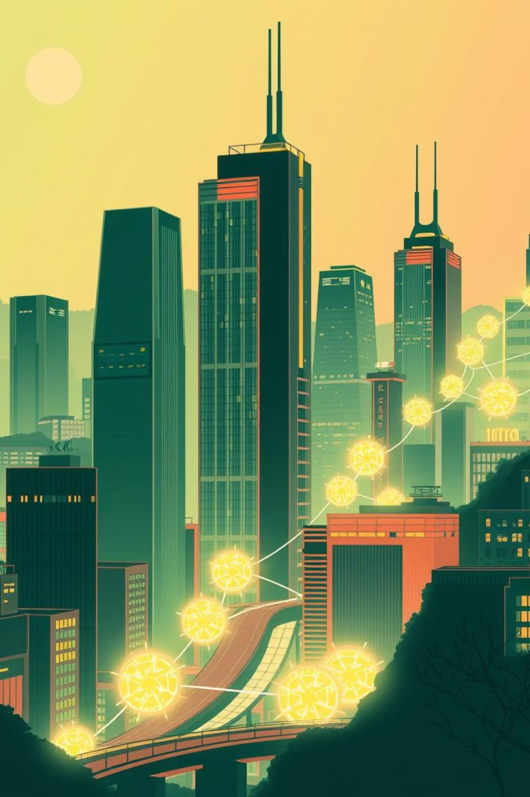


Powering Tomorrow
Decentralized Energy Trading with Blockchain
Presented by: CoreThree
Vineesha, Prasanna, Ruthu
Prasad V Potluri Siddhartha Institute of Technology

Slide 2
Problem Statement
Peer-to-Peer (P2P) Renewable Energy Trading allows households with surplus renewable energy to trade directly with neighbors using blockchain tokens. Companies like Power Ledger, partnered with Google Cloud, have implemented this model globally. This system boosts transparency, scales easily, reduces costs by removing middlemen, and enables real-time settlements while supporting clean energy adoption.Real-life Analogy with Electricity: Think of a colony where some houses generate extra electricity through solar panels. Instead of routing that electricity through a big power station, these houses send it directly to their neighbors through a secure “digital electricity marketplace.” Blockchain tokens work like digital electricity vouchers, ensuring every unit traded is tracked and paid for fairly.Who Are the Users?Producers: Homeowners or businesses generating extra renewable energy.Consumers: Neighbors or businesses buying renewable energy directly.Platform Operators: Manage the blockchain platform, smart contracts, and transactions.Regulators: Oversee legal compliance, safety, and energy standards.Roles & InteractionsProducers provide electricity and earn blockchain tokens.Consumers purchase electricity using tokens.Smart Contracts verify delivery via IoT meter data and release payment instantly.Regulators ensure fair pricing and safety.Connections: Producers and consumers connect directly through the blockchain marketplace, with smart contracts acting as neutral, automated referees and IoT meters confirming each transaction.Smart Contract DeploymentEnergy Marketplace Website/App — where producers list electricity and consumers buy.Automated Payment Settlement — tokens are released when delivery is confirmed.Regulatory Dashboard — real-time transparent records for compliance.Example WorkflowProducer lists available electricity and price.Consumer selects and sends tokens to the smart contract.IoT meters verify delivery.Smart contract transfers tokens to the producer.Blockchain records transaction permanently.This model ensures trust, eliminates unnecessary intermediaries, and promotes sustainable energy use.

Slide 3

User Experience: Simple & Intuitive Dashboard
Our user interface is designed for simplicity, allowing both energy producers and consumers to easily manage their transactions.
Producer Interface
Enter the amount of surplus energy (in kWh) you wish to sell and your desired price per unit. The dashboard instantly displays your available tokens and past sales.
Consumer Interface
Specify the amount of energy you want to buy. The system matches you with available producers, showing your token balance and past purchases. Transaction success or failure is clearly indicated.
The dashboard is designed to be highly responsive, providing real-time updates on transactions and token balances, making energy trading as simple as online shopping.

Slide 4
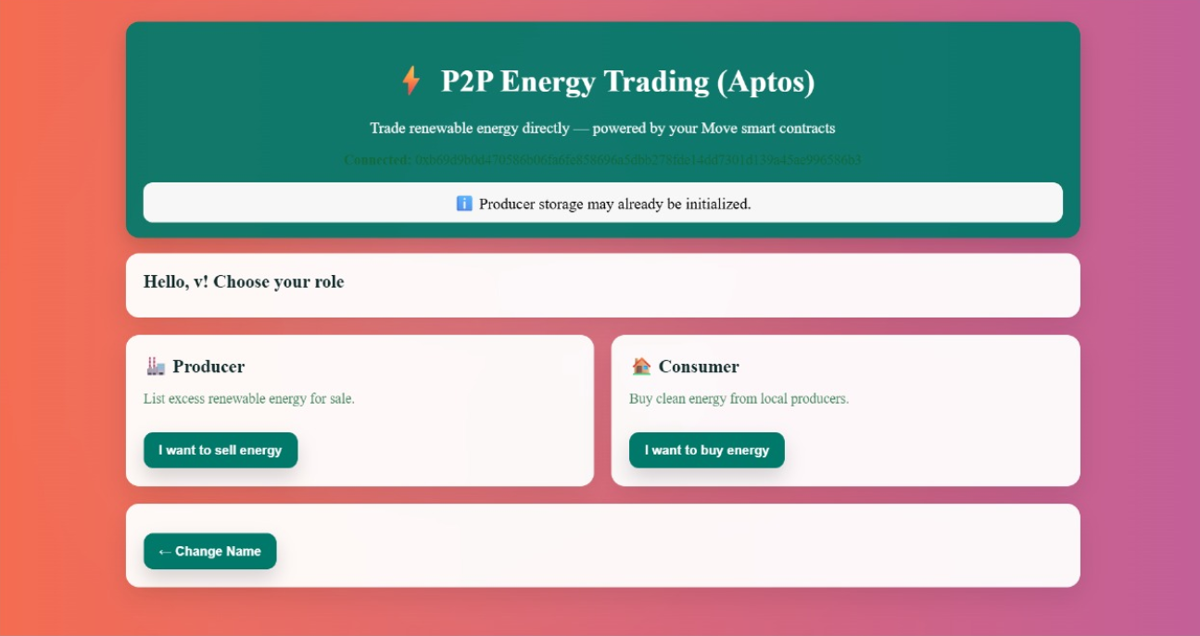
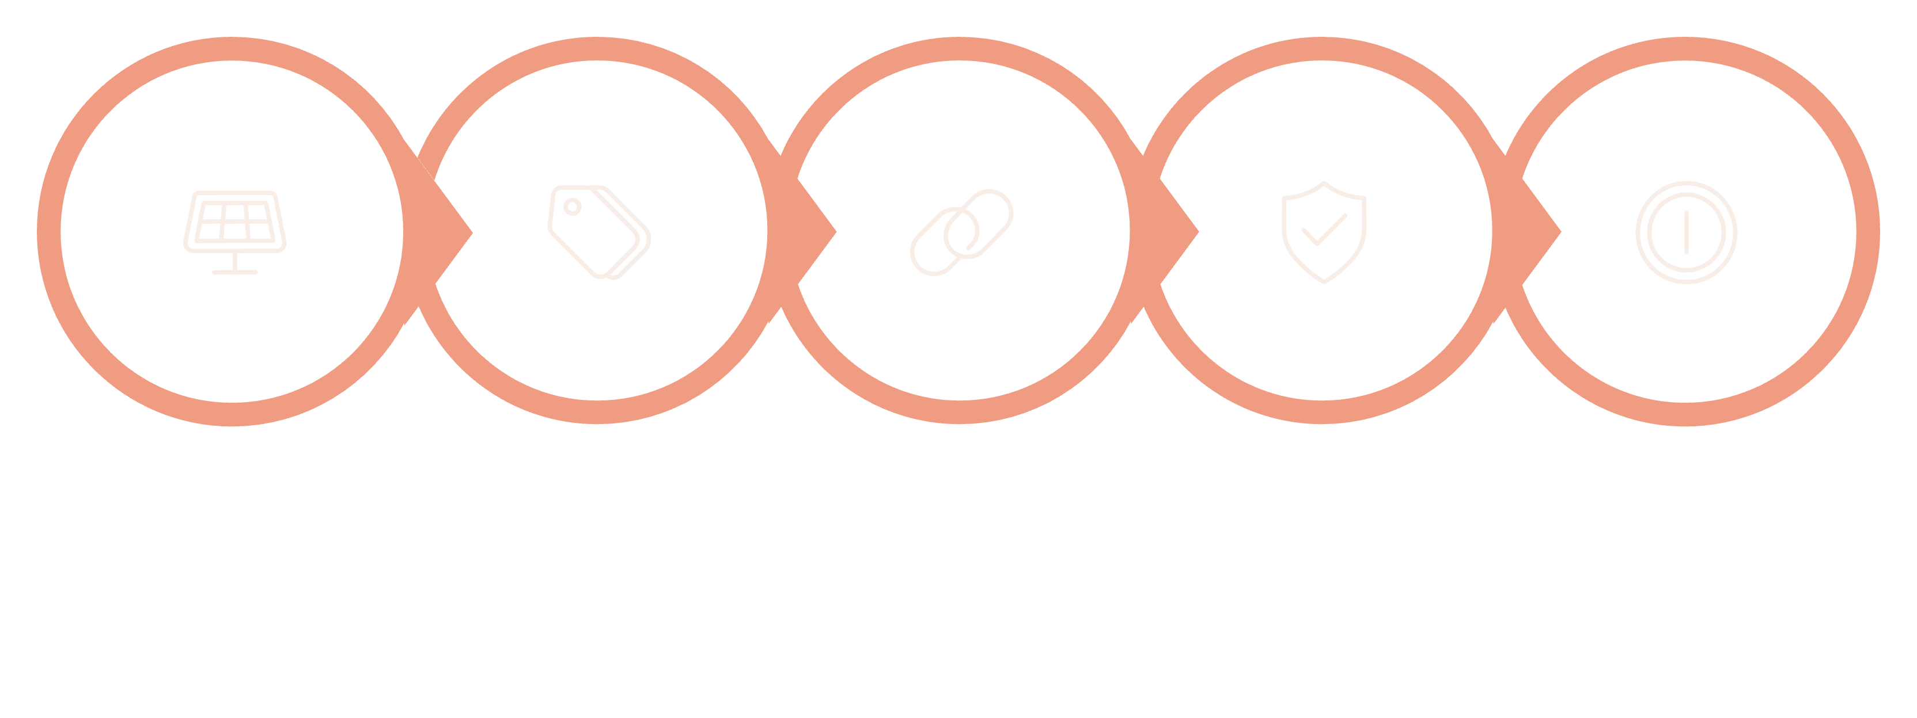





How It Works: The Blockchain Backbone
Generation
Offer
Match
Verification
Settlement
Our system leverages blockchain to provide unparalleled transparency and security for every transaction. Each unit of energy traded is recorded on an immutable ledger, ensuring real-time settlement and preventing fraud. This distributed ledger technology eliminates the need for intermediaries, significantly reducing operational costs and transaction fees for all participants.

Slide 5
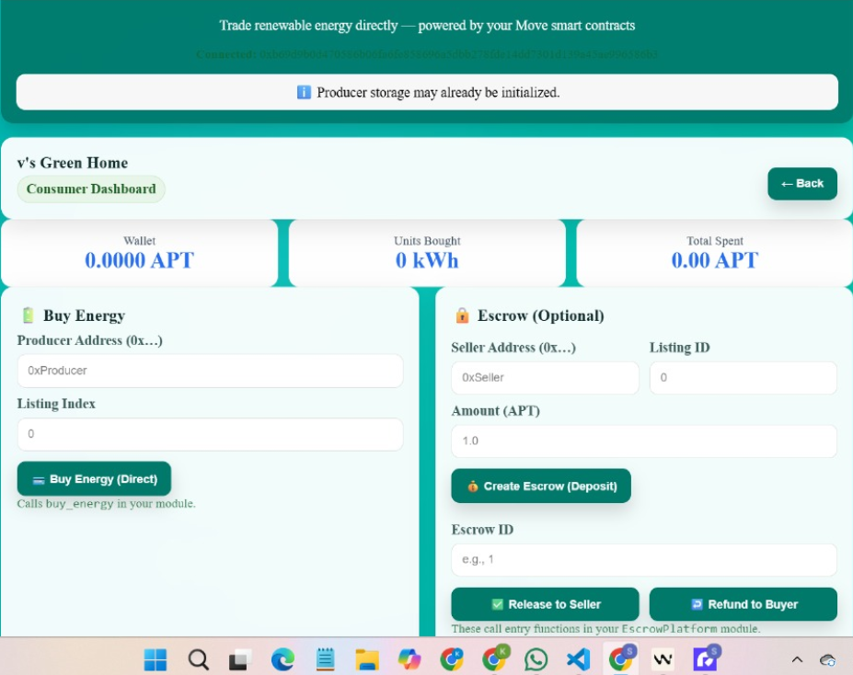
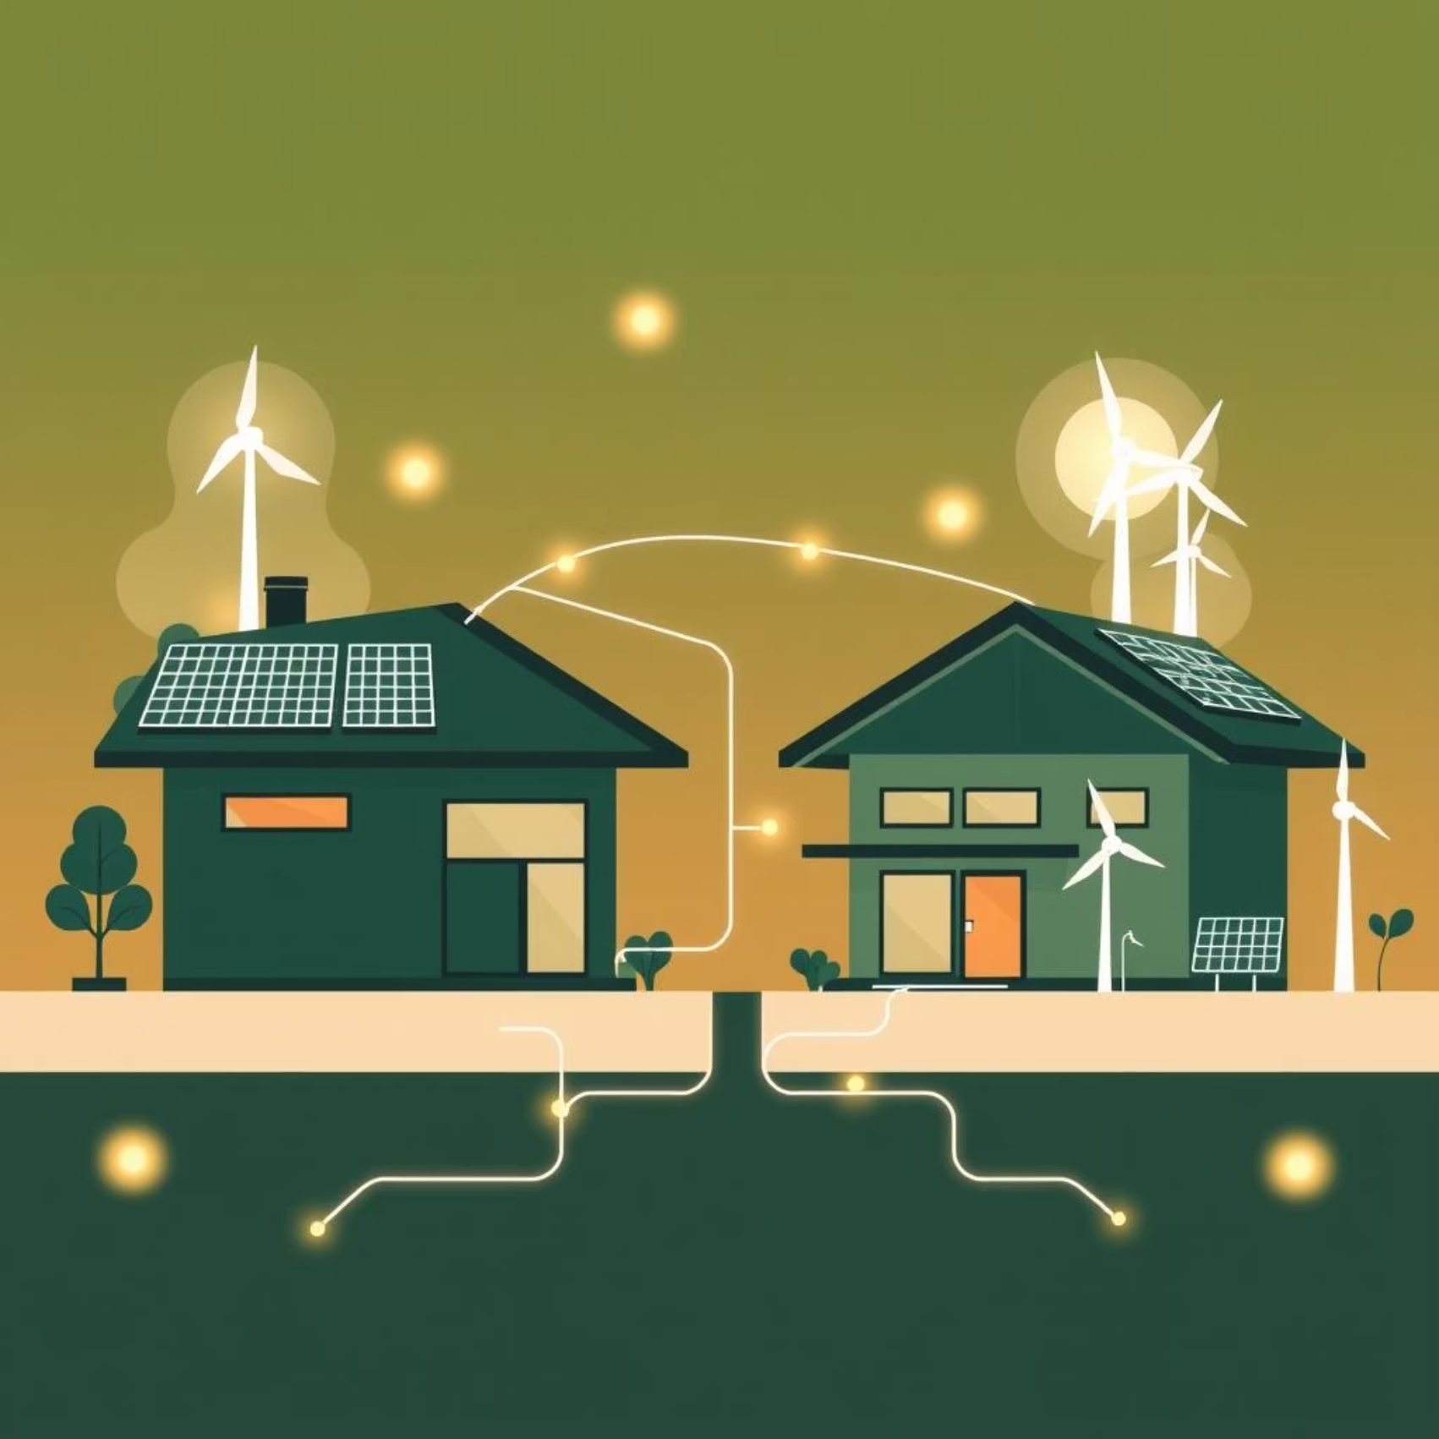
Our Vision: Peer-to-Peer Energy Trading
Imagine a world where your solar panels generate surplus energy, and instead of selling it back to a utility at a fixed rate, you can trade it directly with your neighbor using secure digital tokens. This is the core of our peer-to-peer renewable energy trading platform.
Direct Transactions: Producers (e.g., solar households) sell directly to consumers.
Fair Pricing: Participants can set their own prices, fostering a dynamic market.
Community Empowerment: Local energy ecosystems thrive, reducing reliance on large utilities.
This model ensures that the value of locally produced clean energy stays within the community, promoting energy independence and a more resilient grid.

Slide 6
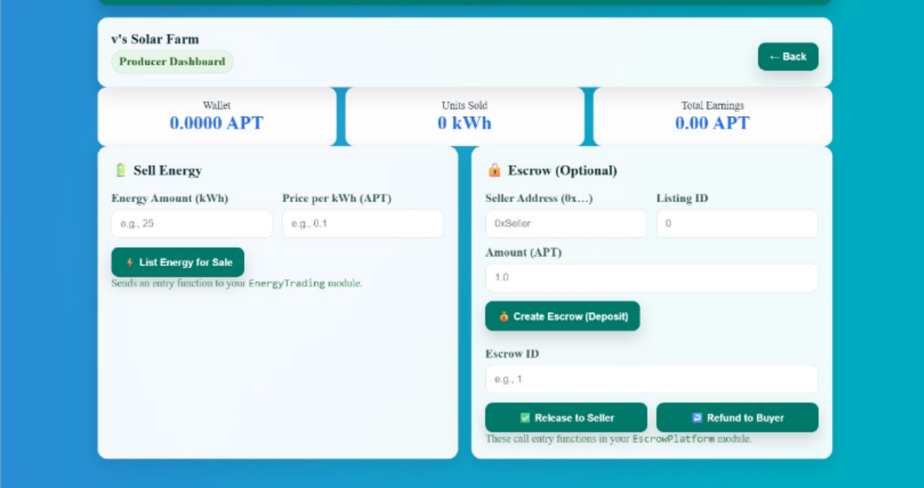
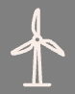

The Energy Revolution: Why Decentralize?
Current Grid Limitations
Growth of Renewables
Blockchain's Promise
Centralized systems lead to inefficiencies, high overheads, and limited individual participation.
The surge in rooftop solar and microgrids demands a flexible, peer-to-peer trading model.
Enables trustless, transparent, and secure transactions, redefining energy markets.
The transition to renewable energy sources, especially distributed generation like rooftop solar, has highlighted the limitations of traditional, centralized electricity grids. Our project addresses these challenges by leveraging blockchain technology to create a truly decentralized energy marketplace.

Slide 7
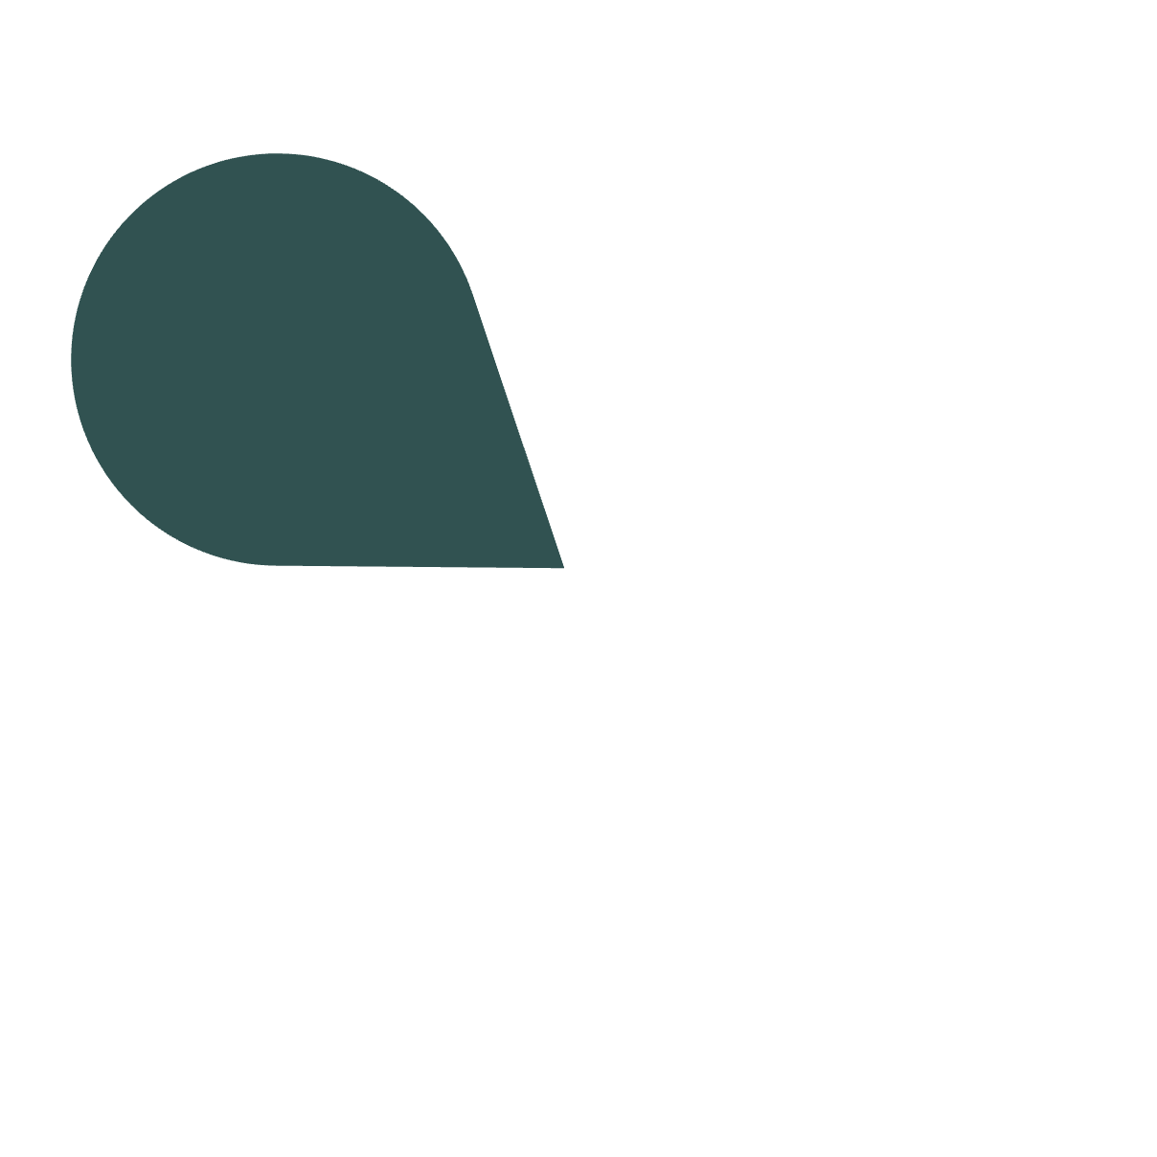
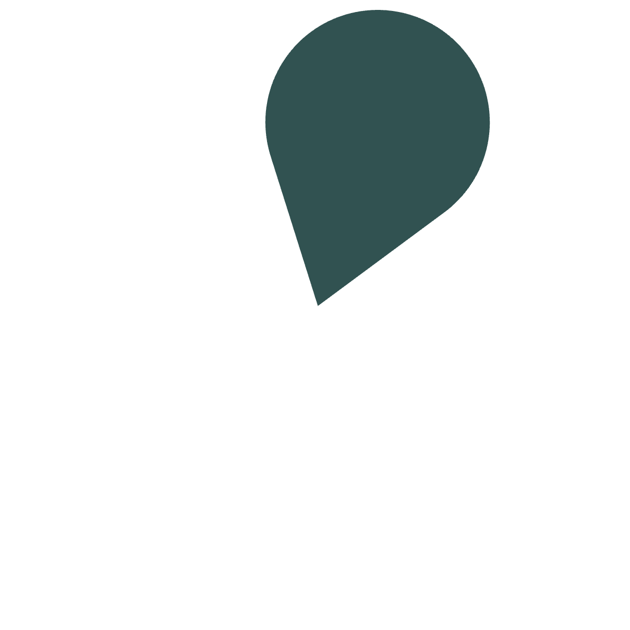
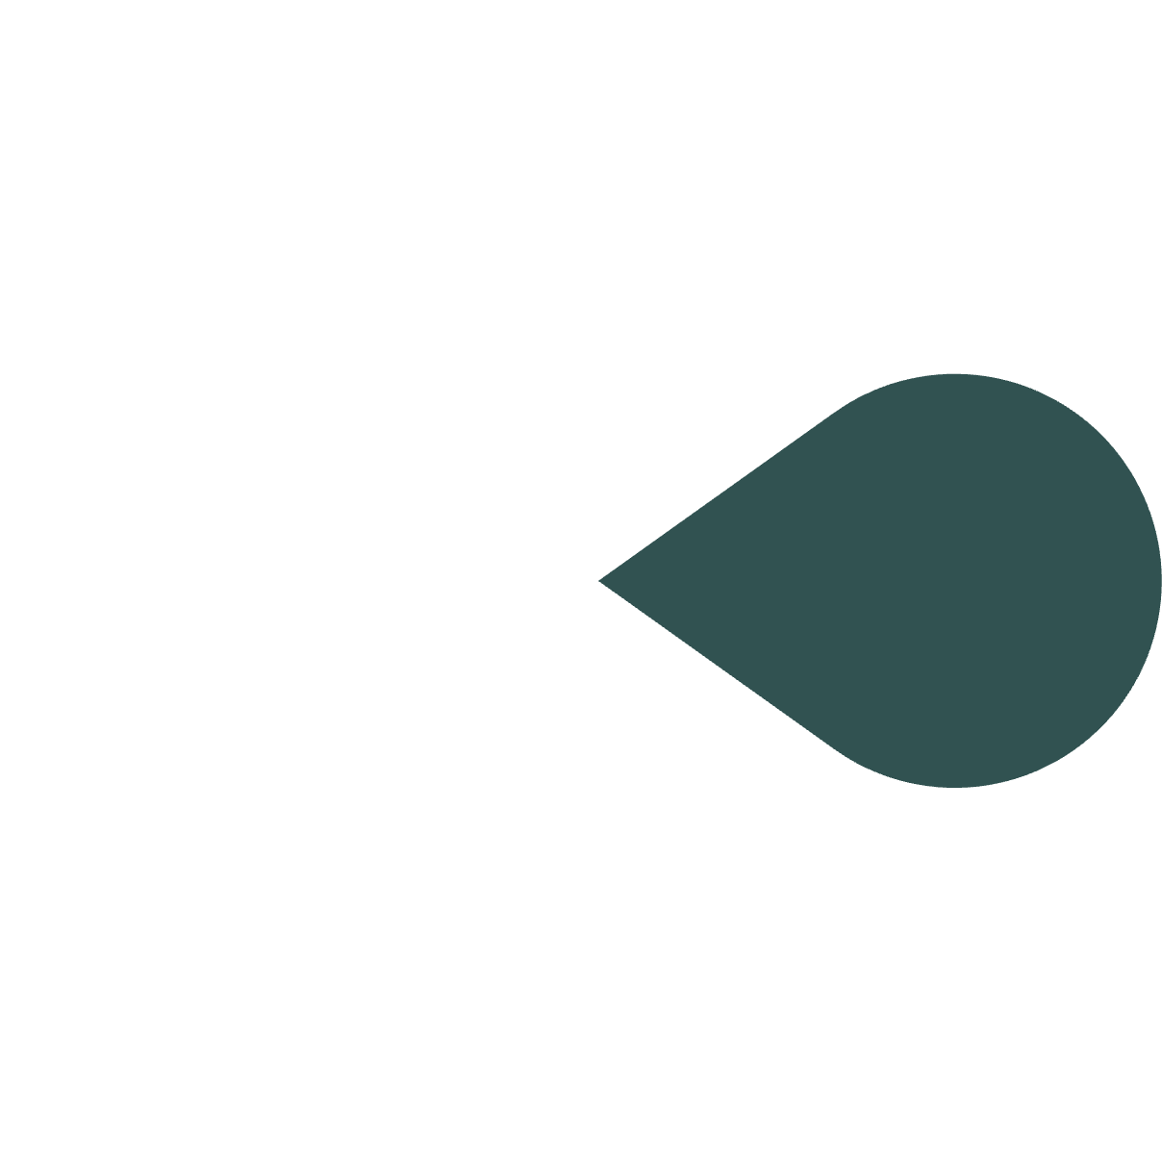
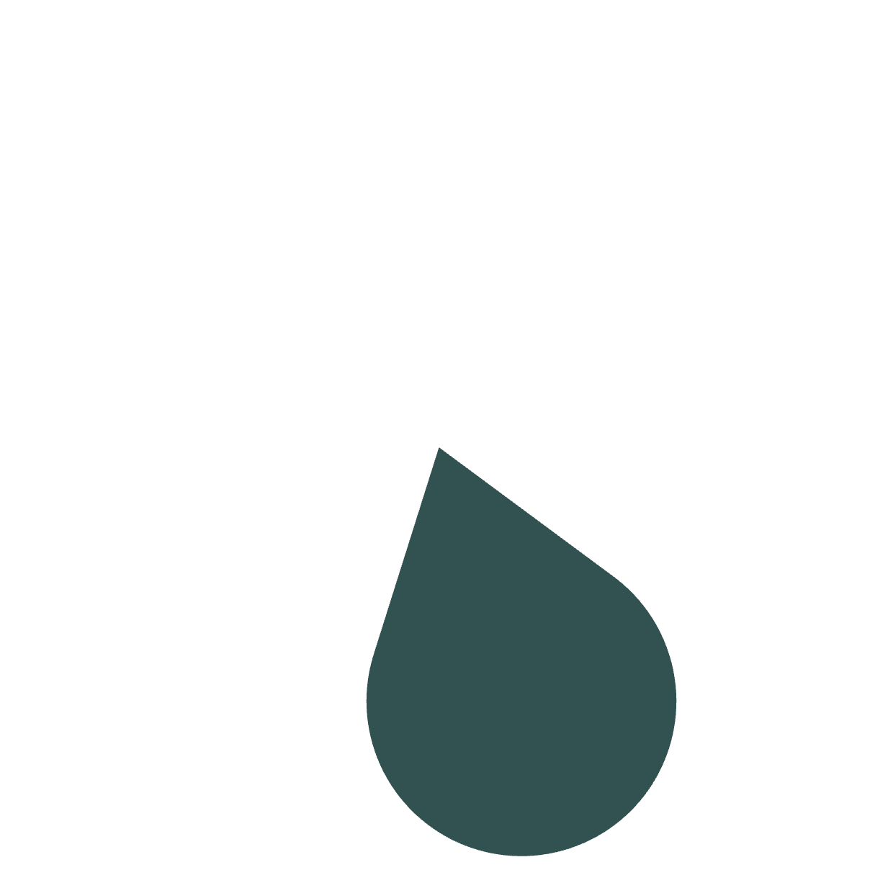
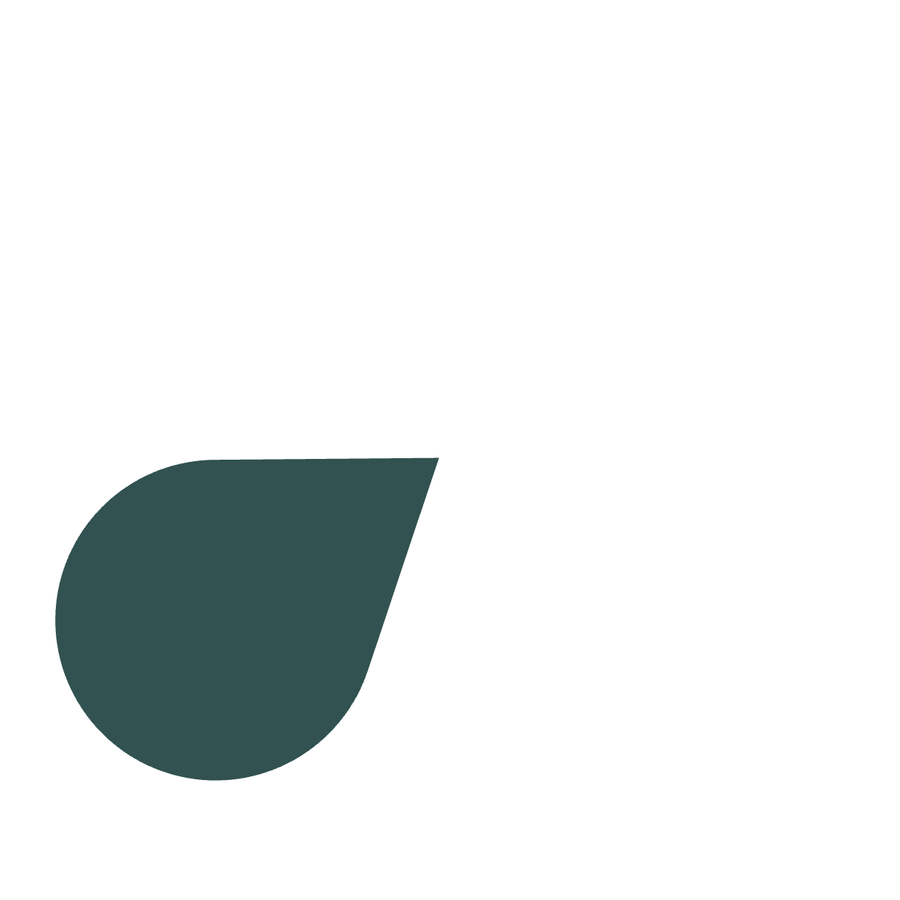



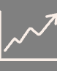

The Impact: A Sustainable Future
Economic Empowerment
Environmental Benefits
Allows individuals to become active participants in the energy market, generating income from their clean energy production.
Accelerates the adoption of renewable energy by making it more economically viable for producers.
Grid Resilience
Diversifies energy sources and strengthens local grids, reducing vulnerability to large-scale outages.
Scalability
Designed to grow with increasing demand, connecting more producers and consumers globally.
Enhanced Transparency
Blockchain's immutable ledger ensures every transaction is recorded, fostering trust and accountability.
Our peer-to-peer energy trading platform is more than just a technological innovation; it's a step towards a decentralized, sustainable, and equitable energy future for everyone.

